Slide 1
Chapter 8
System of Linear Differential Equations

Slide 2
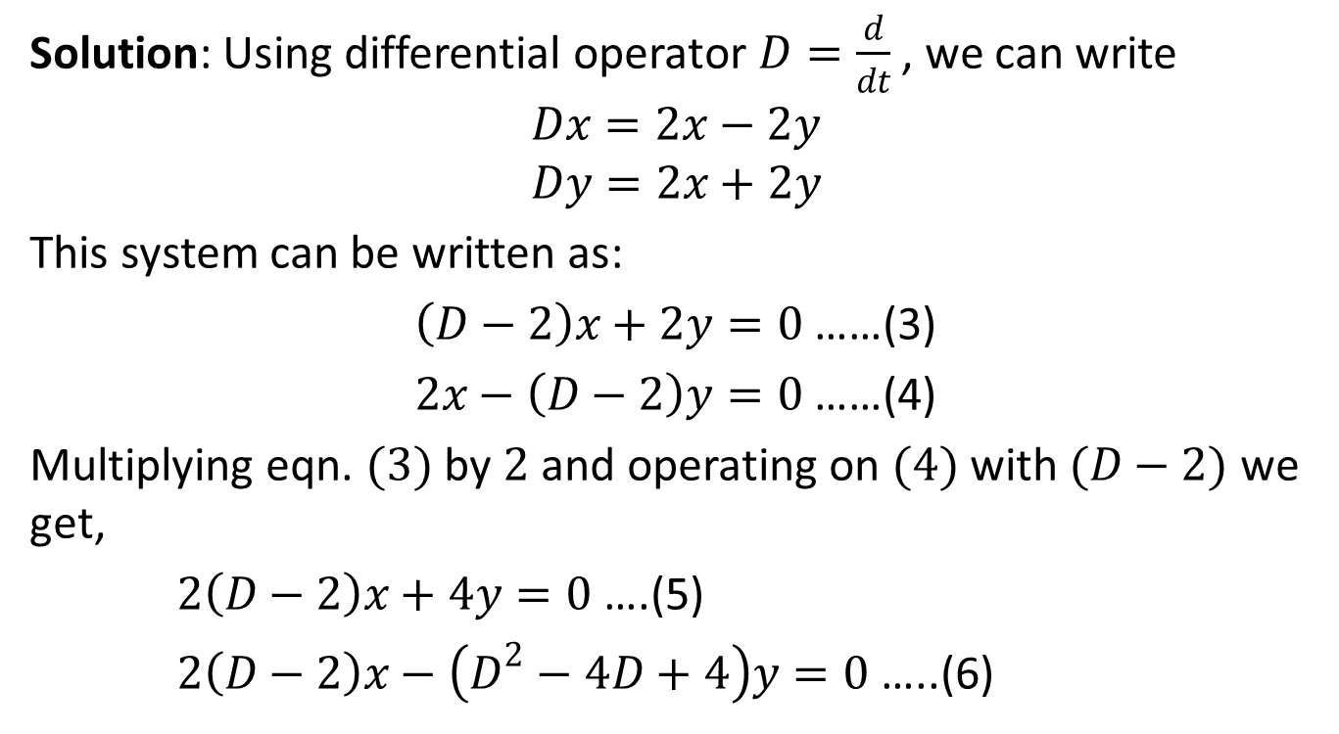
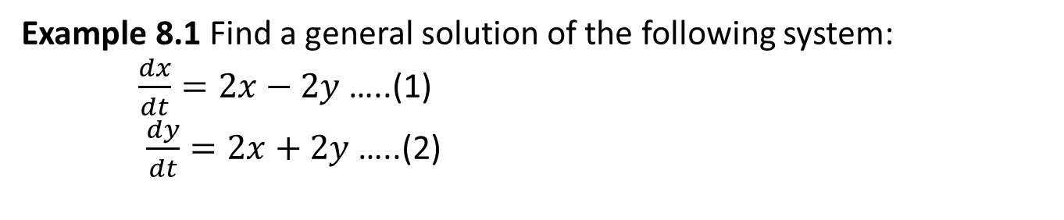
Example 8.1 Find a general solution of the following system: $\frac{dx}{dt}=2x−2y$ …..(1) $\frac{dy}{dt}=2x+2y$ …..(2)
Solution: Using differential operator $D=\frac{d}{dt}$, we can write
$$Dx=2x−2y$$
$$Dy=2x+2y$$
This system can be written as:
$\left(D−2\right)x+2y=0$ ……(3)
$2x−\left(D−2\right)y=0$ ……(4)
Multiplying eqn. $(3)$ by $2$and operating on $(4)$ with $(D−2)$ we get,
$2\left(D−2\right)x+4y=0$ ….(5)
$2\left(D−2\right)x−\left(D^{2}−4D+4\right)y=0$ …..(6)

Slide 3
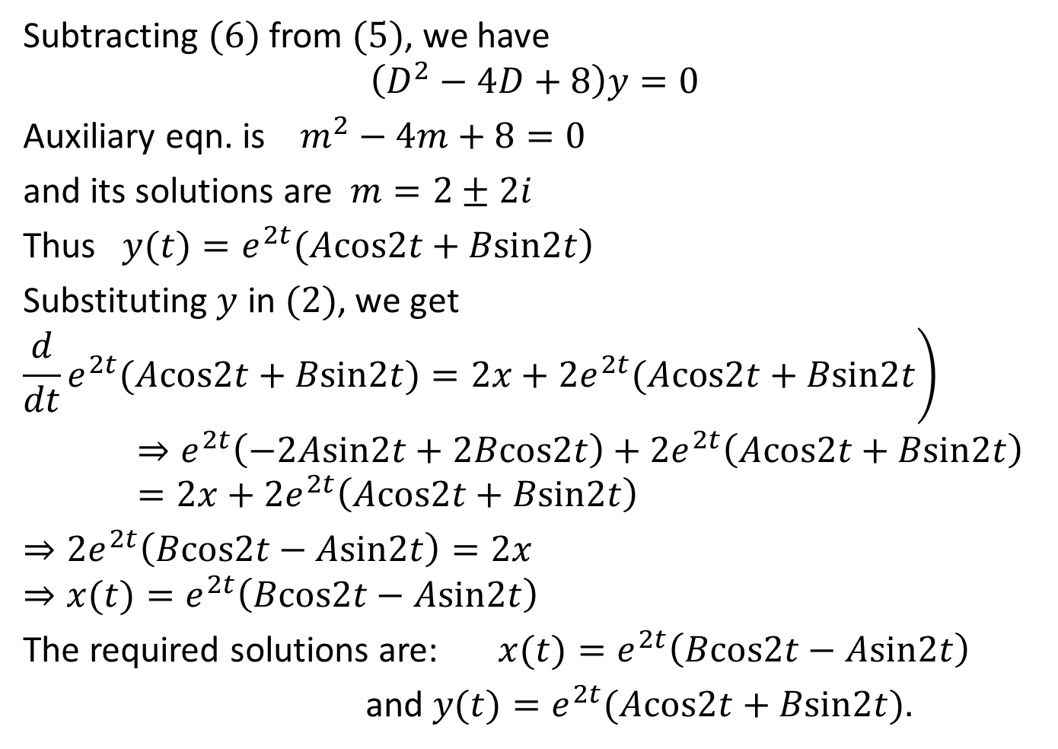
Subtracting $(6)$ from $(5)$, we have
$$\left(D^{2}−4D+8\right)y=0$$
Auxiliary eqn. is $m^{2}−4m+8=0$
and its solutions are $m=2±2i$
Thus $\left.y(t)=e^{2t}(Acos2t+Bsin2t\right)$
Substituting $y$ in $(2)$, we get
$$\left.\frac{d}{dt}e^{2t}(Acos2t+Bsin2t)=2x+2e^{2t}(Acos2t+Bsin2t\right)⇒e^{2t}\left(−2Asin2t+2Bcos2t\right)+2e^{2t}\left(Acos2t+Bsin2t\right)=2x+2e^{2t}\left(Acos2t+Bsin2t\right)$$
$⇒2e^{2t}\left(Bcos2t−Asin2t\right)=2x$
$$⇒x(t)=e^{2t}\left(Bcos2t−Asin2t\right)$$
The required solutions are: $x(t)=e^{2t}\left(Bcos2t−Asin2t\right)$
and $y(t)=e^{2t}(Acos2t+Bsin2t).$

Slide 4
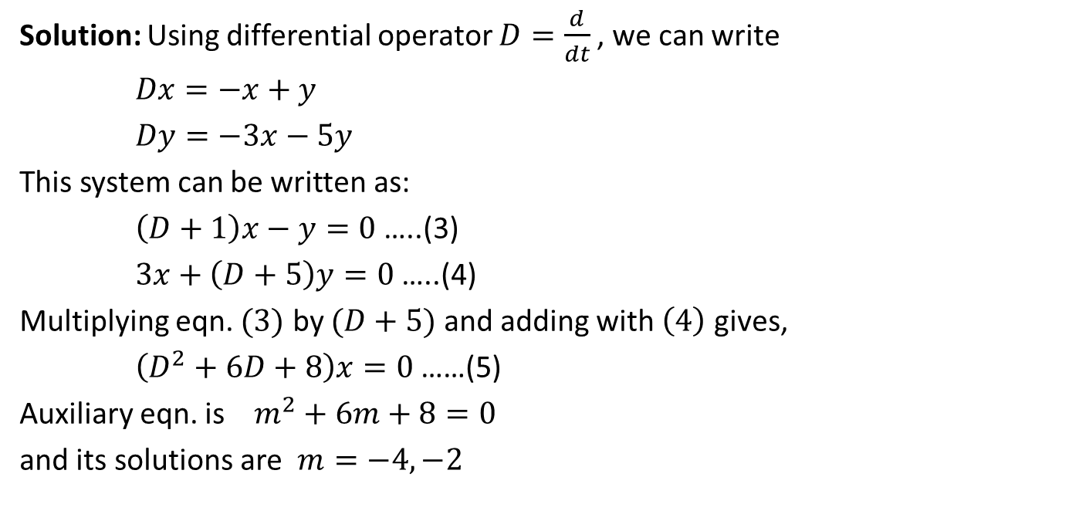
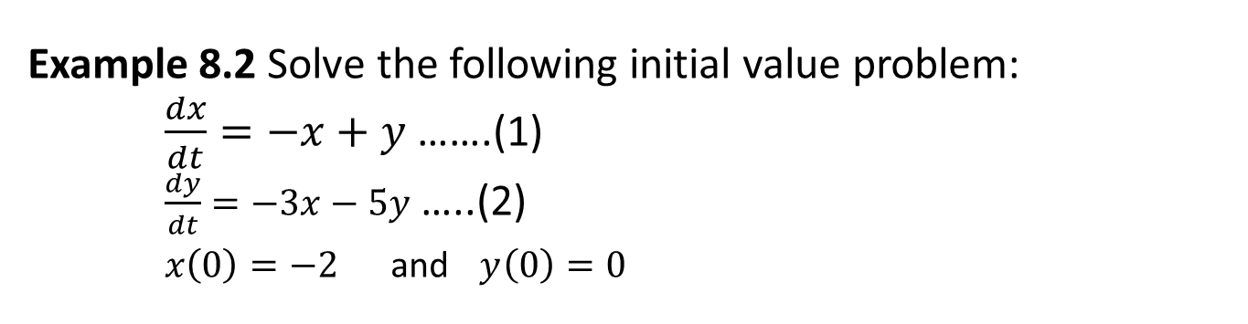
Example 8.2 Solve the following initial value problem: $\frac{dx}{dt}=−x+y$ …….(1) $\frac{dy}{dt}=−3x−5y$ …..(2) $x\left(0\right)=−2 \text{and} y\left(0\right)=0$
Solution: Using differential operator $D=\frac{d}{dt}$, we can write
$Dx=−x+y$
$Dy=−3x−5y$
This system can be written as:
$\left(D+1\right)x−y=0$ …..(3)
$3x+\left(D+5\right)y=0$ …..(4)
Multiplying eqn. $(3)$ by $(D+5)$ and adding with $\left(4\right)$ gives,
$\left(D^{2}+6D+8\right)x=0$……(5)
Auxiliary eqn. is $m^{2}+6m+8=0$
and its solutions are $m=−4, −2$

Slide 5
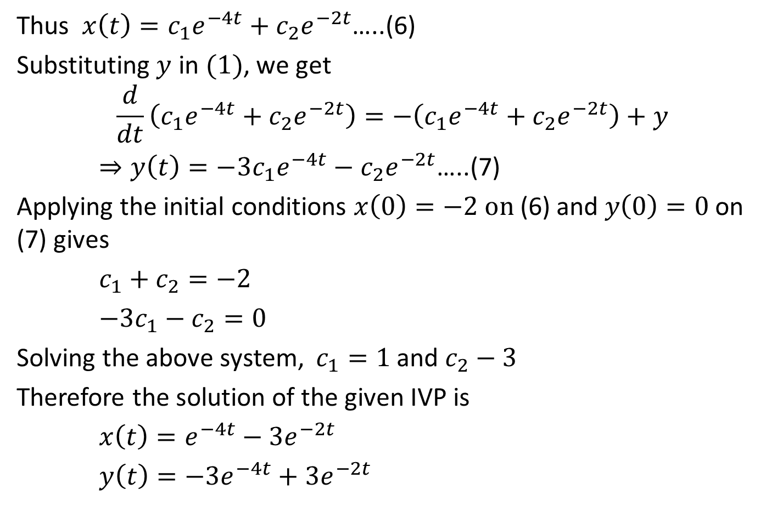
Thus $x\left(t\right)=c_{1}e^{−4t}+c_{2}e^{−2t}$…..(6)
Substituting $y$ in $(1)$, we get
$$\frac{d}{dt}\left(c_{1}e^{−4t}+c_{2}e^{−2t}\right)=−\left(c_{1}e^{−4t}+c_{2}e^{−2t}\right)+y$$
$⇒y\left(t\right)=−3c_{1}e^{−4t}−c_{2}e^{−2t}$…..(7)
Applying the initial conditions $x\left(0\right)=−2 on$ (6) and $y\left(0\right)=0$ on (7) gives
$c_{1}+c_{2}=−2$
$−3c_{1}−c_{2}=0$
Solving the above system, $c_{1}=1$ and $c_{2}−3$
Therefore the solution of the given IVP is
$x\left(t\right)=e^{−4t}−3e^{−2t}$
$y\left(t\right)=−3e^{−4t}+3e^{−2t}$

Slide 6

CW
$\frac{dx}{dt}=x+y$
$\frac{dy}{dt}=4x+y$
$x\left(0\right)=1, y\left(0\right)=6$

Slide 7

Class Practice
Solve the following system of linear differential equations.
1. $\frac{dx}{dt}=2x+2y$
$\frac{dy}{dt}=x+3y$
2. $\frac{dx}{dt}=2x+3y$
$\frac{dy}{dt}=−4y$
3. $\frac{dx}{dt}=−x+y$
$\frac{dy}{dt}=−3x−5y$
Home work:
P-178: 3, 11-(iii), (viii)
P-258: 11
P-262: 26(only solution)
Differential Equations – P. Blanchard, R. L. Devaney, G. R. Hall (4th edition)

Slide 8
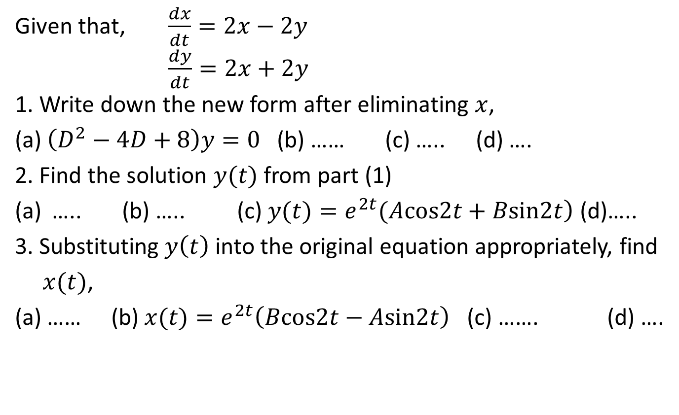
Sample MCQ
Given that, $\frac{dx}{dt}=2x−2y$ $\frac{dy}{dt}=2x+2y$ 1. Write down the new form after eliminating $x$,
(a) $\left(D^{2}−4D+8\right)y=0$ (b) …… (c) ….. (d) ….
2. Find the solution $y(t)$ from part (1)
….. (b) ….. (c) $\left.y(t)=e^{2t}(Acos2t+Bsin2t\right)$ (d)…..
3. Substituting $y\left(t\right)$ into the original equation appropriately, find
$x(t)$,
(a) …… (b) $x(t)=e^{2t}\left(Bcos2t−Asin2t\right)$ (c) ……. (d) ….

Slide 9
THANK YOU

